Slide 1
Norming results
Apr 14, 2026

Slide 2
Our study (VOT tokens generated from a Spanish speaker’s recordings)

Slide 3
Norming experiment
N=30 (two excluded due to lack of engagament, one excluded due to overall flat categorization curve) → leaving N=27
Stimuli: 23-step VOT continua for dill/till, din/tin, dip/tip *VOT steps -100, -50, -20, -10, 0, 5, 10, 15, 20, 25, 30, 35, 40, 45, 50, 55, 60, 65, 70, 80, 90, 100, 120
Design: 3 word x 23 step x 4 repetition + 12 catch trials = 288 trials

Slide 4
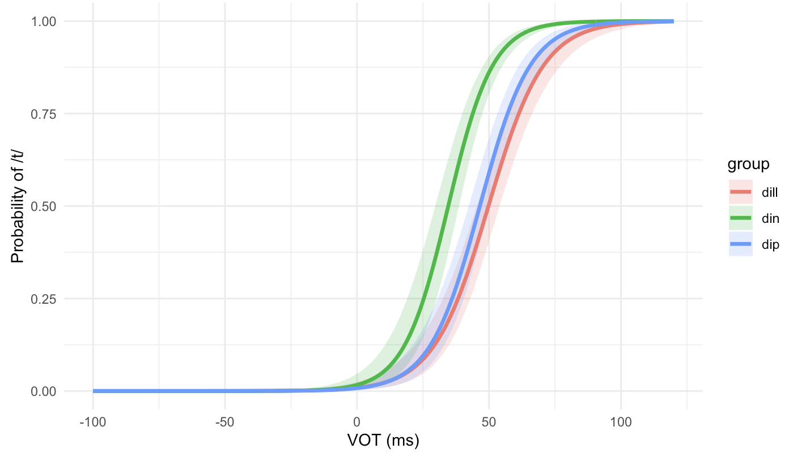
Group-level results

Slide 5
Group-level results
dip: 46.55ms
din: 34.58ms
dill: 49.8ms

Slide 6
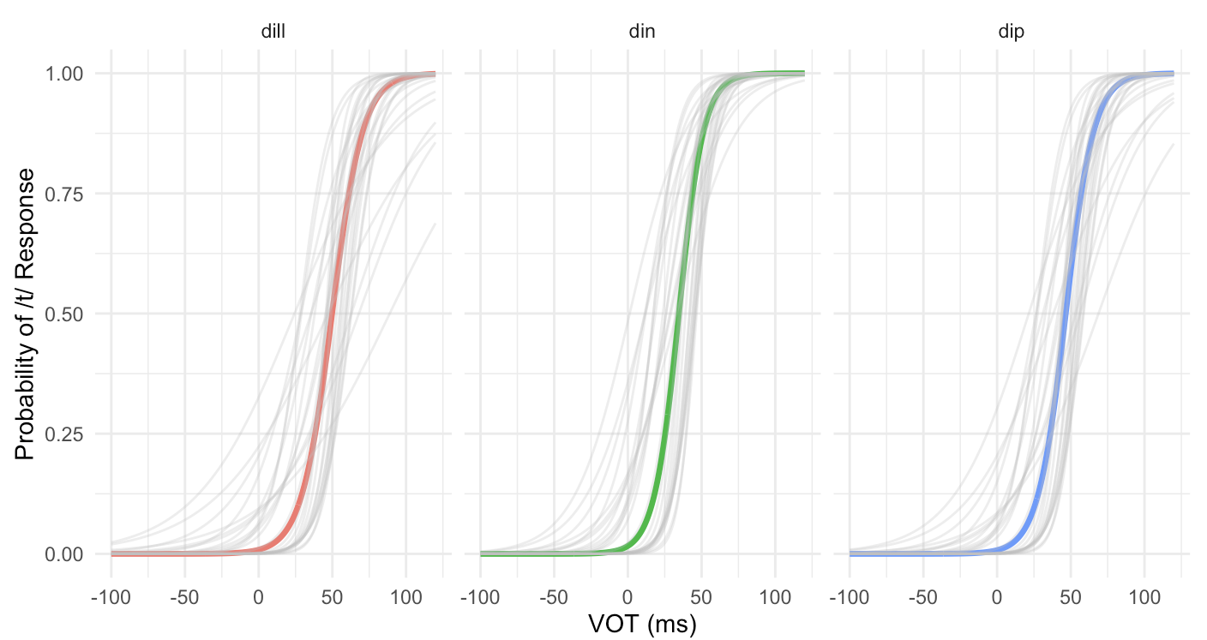
Zoom into each word with individual categorization curves

Slide 7
Tan & Jaeger (2025) (VOT tokens generated from a native English speaker’s recordings)

Slide 8
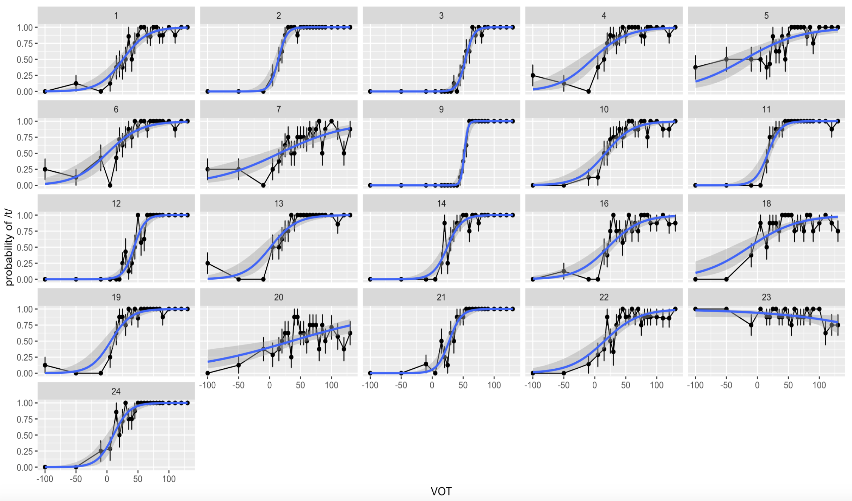
Norming data from Tan & Jaeger (2025)
exclude

Slide 9
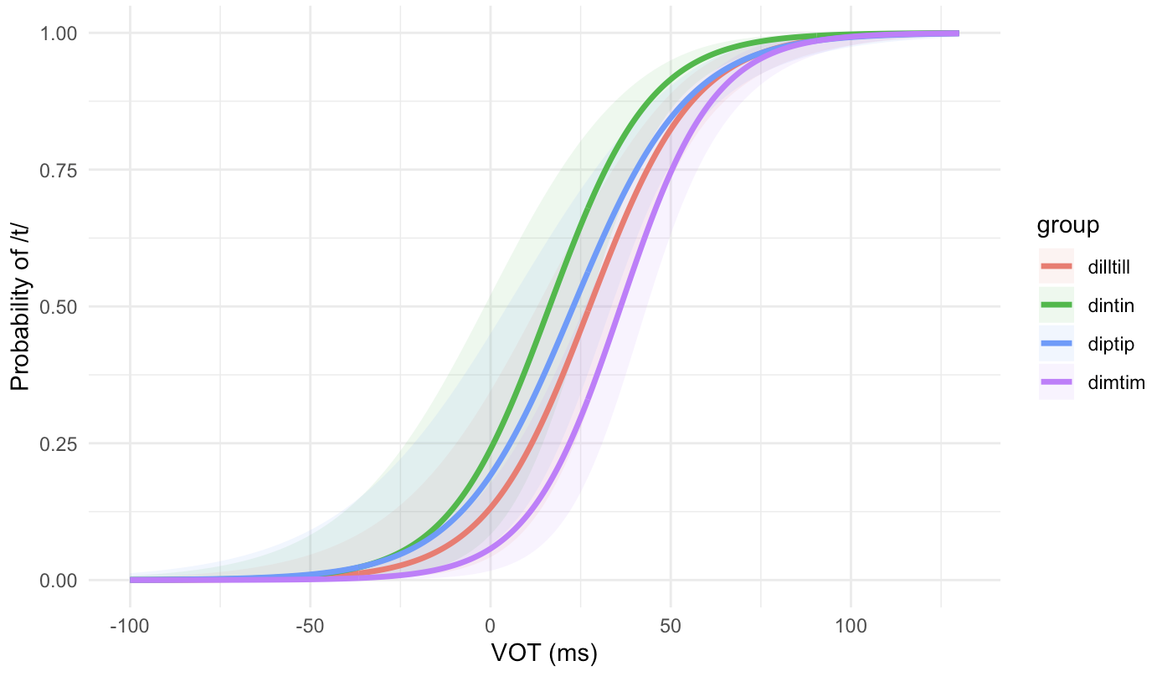
Norming data from Tan & Jaeger (2025)

Slide 10
Norming data from Tan & Jaeger (2025)
dip: 22.97ms
dim: 36.13ms (*EXCLUDED from main experiment)
din: 16.38ms
dill: 27.49ms

Slide 11
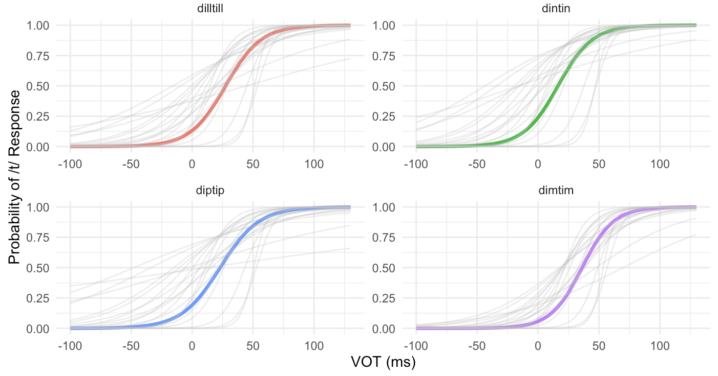
Norming data from Tan & Jaeger (2025)

Slide 12
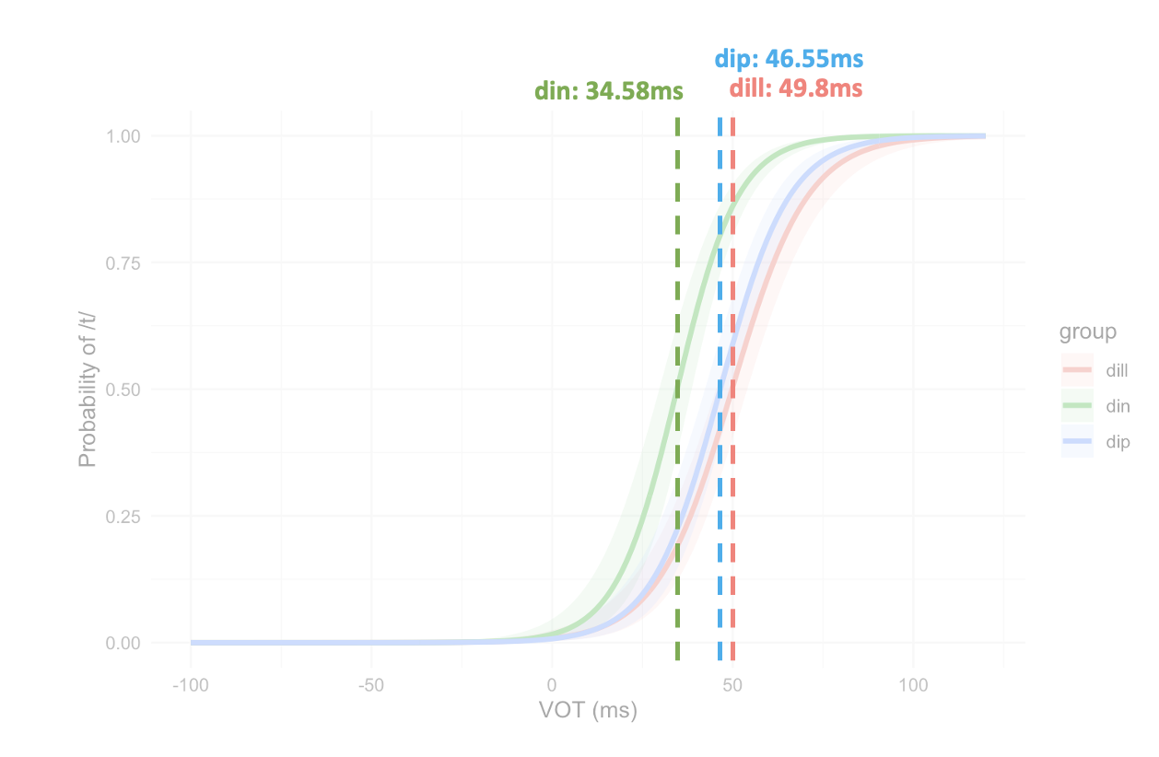
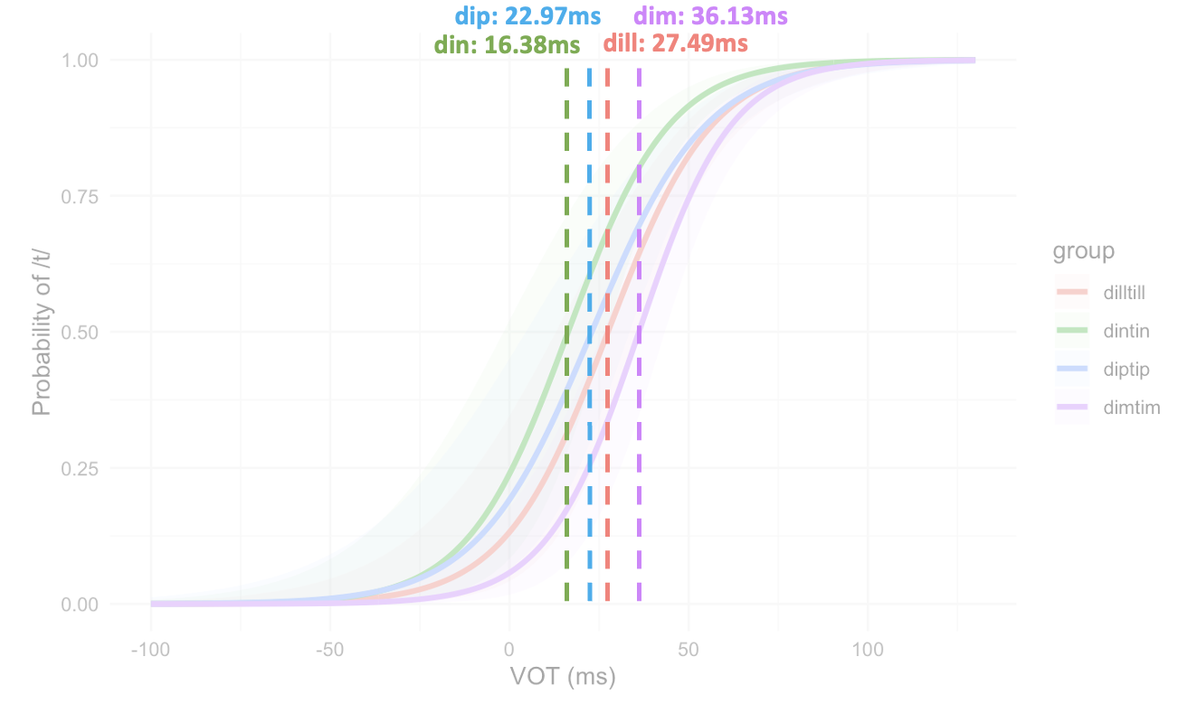
Comparison
Our study
Tan & Jaeger (2025)
VOT boundary appears to be more positive for our stimuli [cf. Tan & Jaeger (2025)]
Less variable categorization responses elicited by stimuli in our study than Tan & Jaeger’s

Slide 13
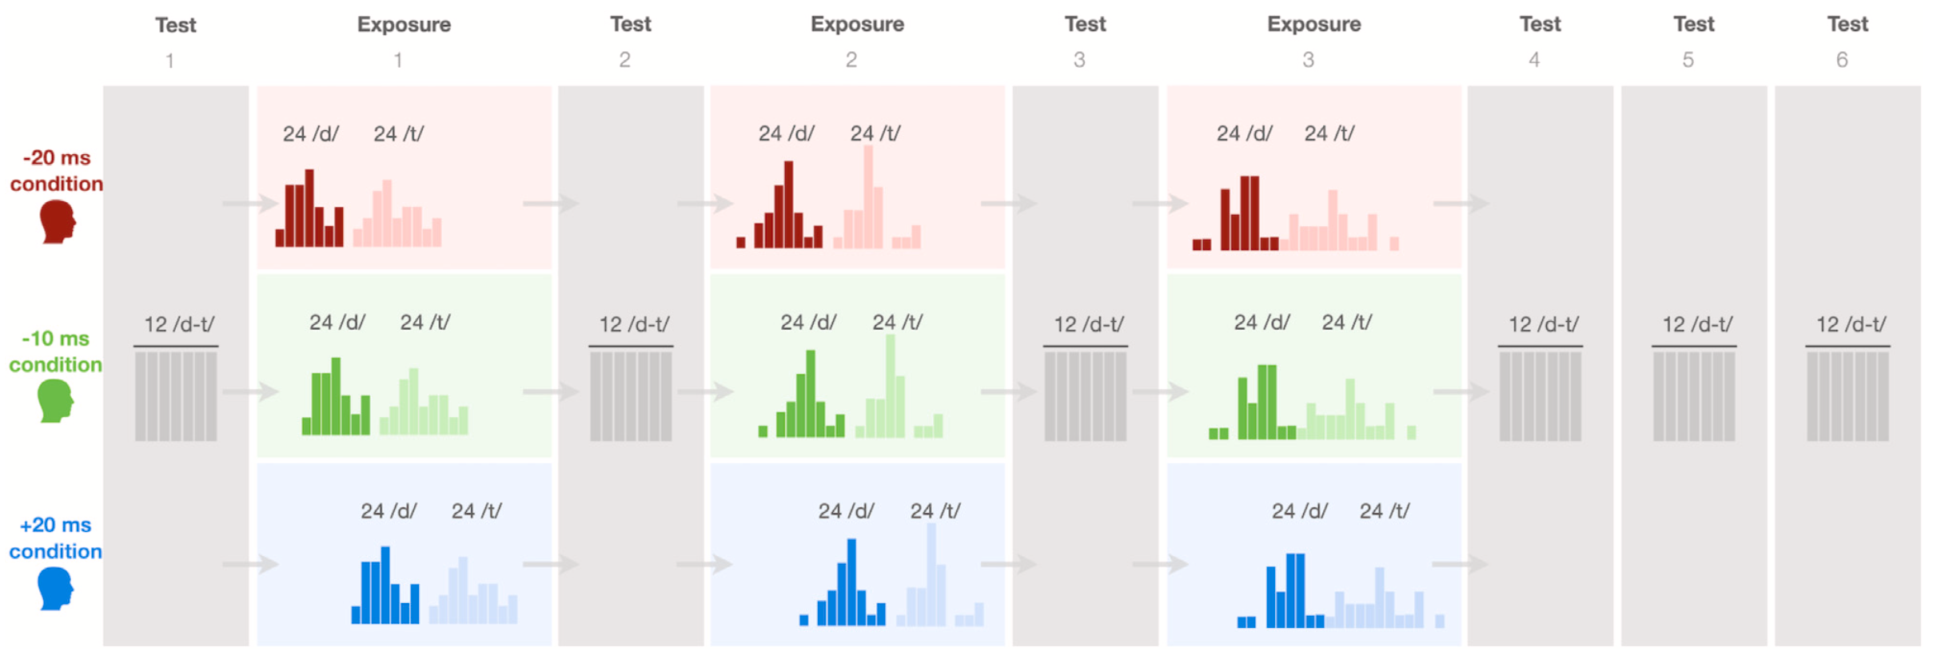
Next steps
Would our specific choice for the main experiment be modified in light of our norming results (e.g., more positive VOT boundaries), or we just follow as closely as possible to Tan & Jaeger’s design?
Creating exposure and testing blocks

Slide 14
Next steps
Testing blocks
Tan & Jaeger (2025): 12 minimal pair trials assessing participants’ categorization at 12 different VOTs (−5, 5, 15, 25, 30, 35, 40, 45, 50, 55, 65, 70 ms)
→ same testing range? Counterbalancing: the assignment of VOTs to minimal pair continua within and across test blocks *Each minimal pair appear equally often within each test block (3 pair x 4 times), and each minimal pair appear with each VOT equally often (twice) across all six test blocks (and no more than once per test block).

Slide 15
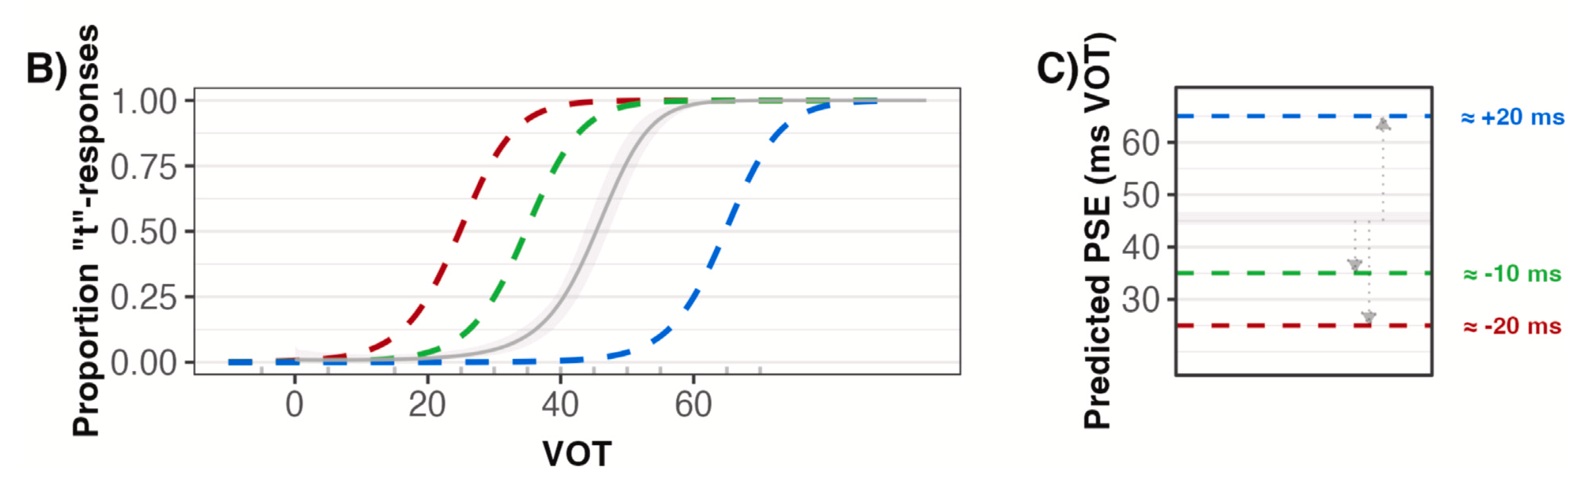
Next steps
Exposure blocks
Exposure condition: -20ms, -10ms and +20ms?
*three conditions that shifted exposure distributions to different degrees relative to listeners’ prior expectations
→ listeners’ prior expectations for VOT productions from a native English speaker or a Spanish speaker?

Slide 16
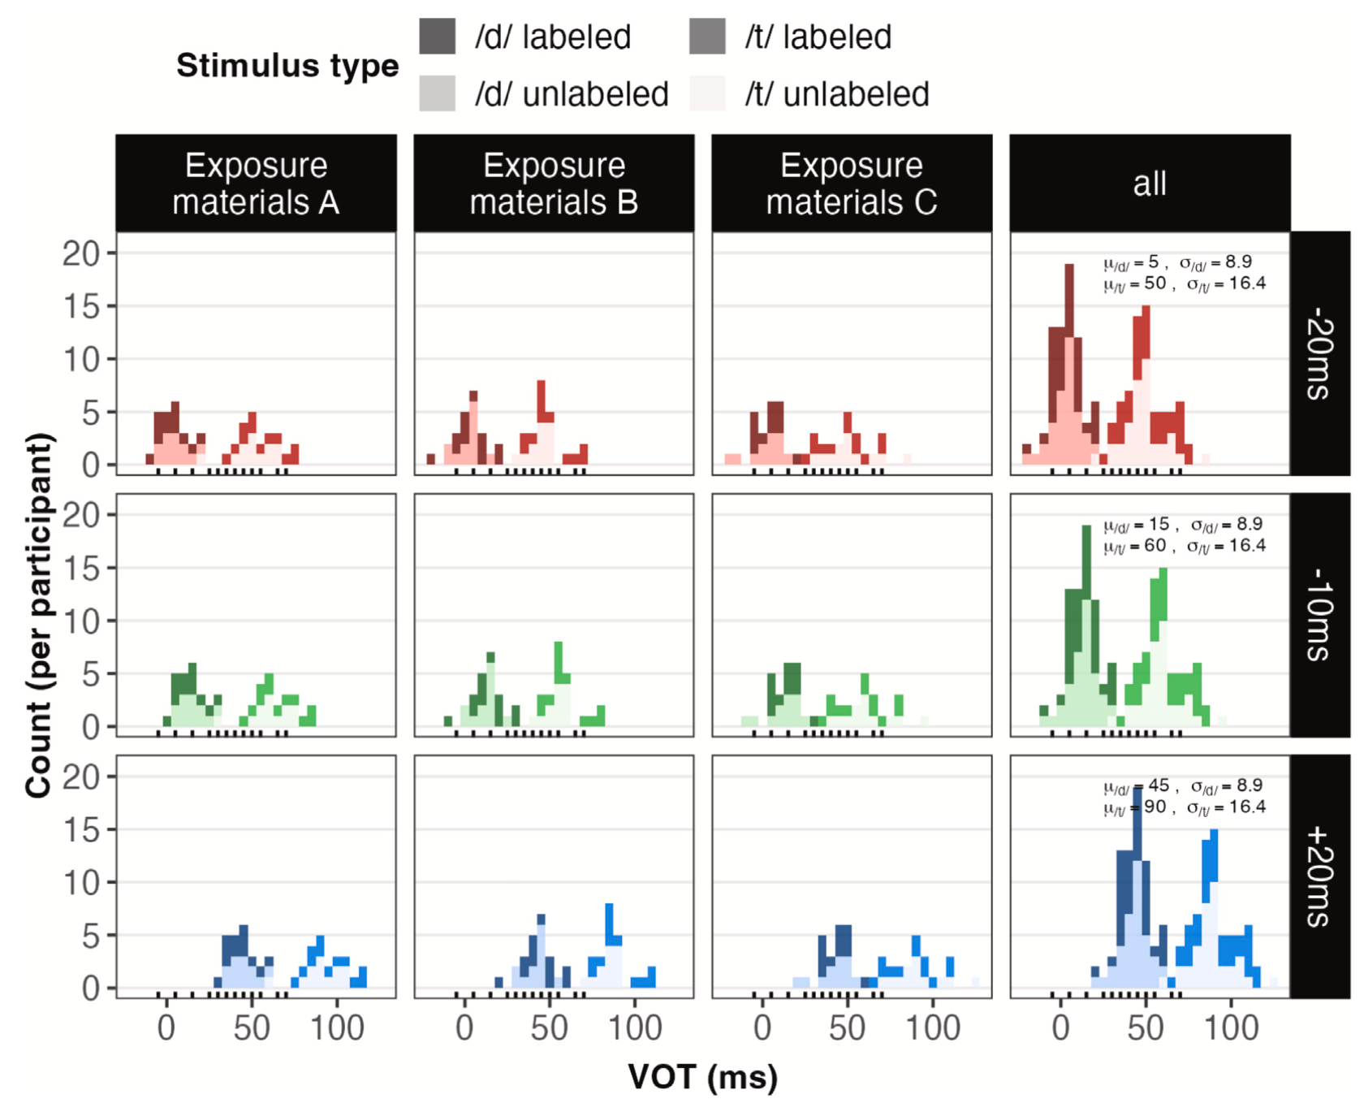
Next steps
Exposure blocks
21 distinct VOT locations (across three minimal pairs) during exposure: (a) -20ms condition: all 5ms-steps from -20ms~75ms + 85ms token (b) -10ms condition: all 5ms-steps from -10ms~85ms + 95ms token (c) +20ms condition: all 5ms-steps from 20ms~115ms + 125ms token
→ same tokens? → same phonetic distribution (in terms of mean and SD)?

Slide 17
Next steps
Exposure blocks
To-do
Create one condition first (e.g., -20ms condition): randomly sampling tokens for intended VOT distribution for three exposure blocks, then counterbalanced the block order across participants within the same exposure condition half labeled, half unlabeled
For other conditions: simply shift the values of the whole selected VOT tokens by intended amount, then reselect the corresponding VOT tokens to from new distribution

Slide 18
Next steps
Setting up the “Spanish speaker” scenario
Picture of a Spanish speaker
Background story
Experiment instruction by Spanish speaker

Slide 19
2026/06/05 updates
Full dataset - N=30
Revisit data exclusion criteria
Participant-level exclusion: low accuracy in catch trials (N=2), over 15% trials with RTs < 200ms (N=4), flat categorization curve (N=1), RT +-3D from group mean (N=0)

